Slide 1





PaMs within NECP
Training on reporting obligations for the adapted
Governance Regulation, Sarajevo, 7-9.10.2025.godine
Implementira konzorcij predvođen DAI

Slide 2

Policies and Measures (PaMs) within the NECP of Bosnia and Herzegovina
Role of Policies and Measures (PaMs):
Policies and measures represent the central element of implementing the Integrated Energy and Climate Plan of Bosnia and Herzegovina (NECP).They include legal, institutional, financial, and technical instruments that enable the achievement of the five dimensions of the Energy Union:
Decarbonisation,
Energy efficiency,
Energy security,
Internal energy market,
Research, innovation, and competitiveness.
Purpose of Developing and Reporting on PaMs:
Ensure transparency in the implementation of policies and achievement of objectives by 2030.
Establish a system that allows quantification of each measure’s contribution to the reduction of greenhouse gas (GHG) emissions.
Link the implementation of measures with the MRV system (monitoring – reporting – verification).
Enable the preparation and automatic generation of reports to the European Environment Agency (EEA) and the European Commission (DG ENER, DG CLIMA).
Methodological Framework:
PaMs are developed based on the EEA methodology (Reporting Guidelines 2023) and Regulation (EU) 2018/1999 on Energy Union Governance, which defines the following obligations:
Policies and Measures (PaMs): qualitative and quantitative description of measures by sector.
Projections: assessment of the effects of measures on emissions and energy consumption.

Slide 3
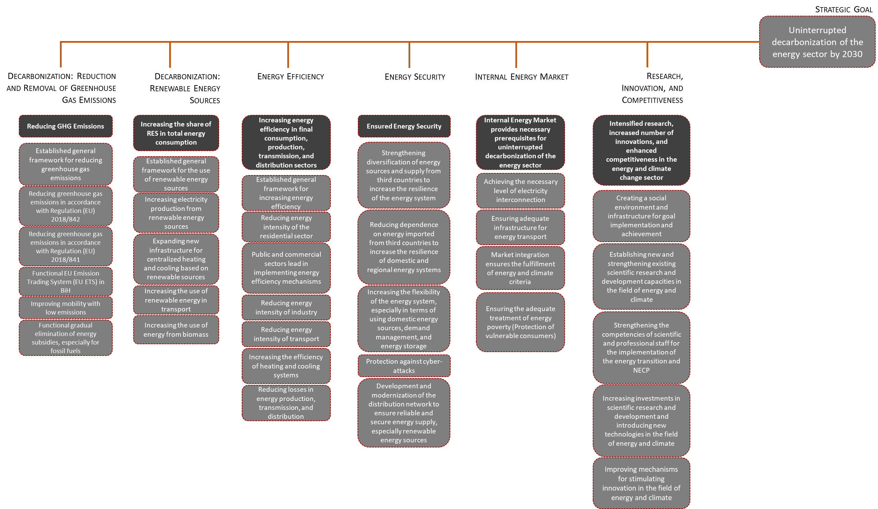
Policies and Measures (PaMs) within the NECP of Bosnia and Herzegovina

Slide 4
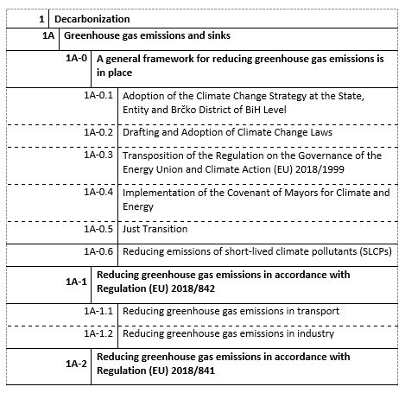
Decarbonization: Greenhouse Gas Emissions
Objective: Reduce greenhouse gas emissions and gradually introduce market mechanisms that will enable a fair, cost-effective, and transparent decarbonization of the energy sector in Bosnia and Herzegovina.
Policies and Measures:
Establishing a General Framework for Greenhouse Gas Emission Reduction – Adoption of an overarching legislative and institutional framework for GHG emissions management in line with EU Regulation 2018/842.
Reduction of Greenhouse Gas Emissions in Accordance with Regulation (EU) 2018/842 – Definition of sectoral targets and indicators for emission reductions by 2030.
Reduction of Greenhouse Gas Emissions in Accordance with Regulation (EU) 2018/841 (LULUCF) – Integration of the land use, land-use change, and forestry sector into the emissions and removals monitoring system.
Functioning of the Emissions Trading System (ETS) – Establishment of a national ETS BiH aligned with the EU model, with the gradual inclusion of the energy and industrial sectors.
Improvement of Low-Emission Mobility – Promotion of electric and hybrid vehicles, development of charging infrastructure, and integration with sustainable urban mobility plans.
Functional Gradual Phase-Out of Energy Subsidies, Especially for Fossil Fuels – Reform of subsidies that encourage CO₂ emissions, with the reallocation of public funds toward energy transition and just transition workforce programs.

Slide 5
Dekarbonizacija: Emisije stakleničkih gasova
Reporting:
PaMs Report: Description of measures and their effects by sector (energy, industry, transport, waste, agriculture).
GHG Report: Calculation of emissions by gases (CO₂, CH₄, N₂O, F-gases).
LULUCF Report: Balance of sinks and emissions from the land use and forestry sectors.
Adaptation Report: Assessment of climate risks and resilience measures by sector..
Mitigation, Adaptation and LULUCF – Interlinkages and Differences
Mitigation encompasses policies and measures aimed at reducing greenhouse gas emissions through the transformation of the energy system, industry, transport, agriculture, and waste sectors, in line with Regulation (EU) 2018/842 and Directive 2003/87/EC on the Emissions Trading System (EU ETS).
Adaptation refers to reducing the vulnerability of society and the economy to the impacts of climate change, including measures to enhance the resilience of infrastructure, agriculture, water resources, and health, in accordance with the EU Strategy on Adaptation to Climate Change (COM(2021)82) and Regulation (EU) 2018/1999.
LULUCF (Land Use, Land Use Change, and Forestry) has a specific role as it integrates the balance of emissions and removals from land and forestry sectors, tracking the capacity of natural systems to absorb CO₂, in line with Regulation (EU) 2018/841.

Slide 6
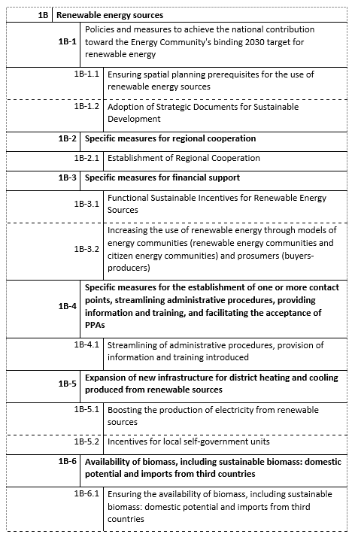
Decarbonisation: Renewable Energy Sources (RES)
Objective:
Increase the share of renewable energy sources (RES) in gross final energy consumption by 2030 through a stable regulatory framework, financial support, and strengthened regional cooperation.
Policies and measures:
Establish a general framework for the use of renewable energy sources in accordance with Regulation (EU) 2018/2001 (RED II).
Establish and implement regional cooperation in the field of RES (data exchange, joint initiatives, cross-border projects).
Ensure financial support for the development and incentives for RES projects (auction systems, subsidies, green loans).
Streamline administrative procedures, digitalise processes, and improve investor information.
Expand and modernise infrastructure for centralised heating and cooling from RES.
Increase the use of biomass energy through the development of sustainable supply chains and sustainability criteria.
Increase the share of renewable energy in transport through the development of infrastructure for biofuels, electricity, and hydrogen.

Slide 7
Decarbonisation: Renewable Energy Sources (RES)
Reporting:
Report on Progress Toward Renewable Energy Targets: monitors the overall share of RES in gross final energy consumption, including electricity, heating and cooling, and transport.
PaMs Report: describes policies and measures contributing to increasing the RES share by sector, with an assessment of effects on emissions and the energy balance.
Projections Report: provides projections of RES shares and their contribution to reducing greenhouse gas emissions by 2030.
Financing Report: reviews financial instruments and public investments for the development of RES projects.
EE Report: records the contribution of RES in heating and cooling systems in the context of overall efficiency.
Regional Cooperation Report: documents progress in cross-border cooperation and joint projects in accordance with Article 8 of the RED II Directive.
Additional RES Report: provides a detailed breakdown of RES contributions by sector and technology (solar, wind, hydro, biomass, biogas, geothermal).

Slide 8
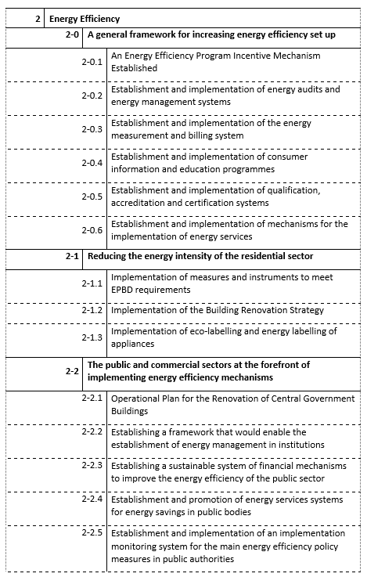
Energy Efficiency
Objective:
Increase energy efficiency across all sectors — particularly in buildings, industry, transport, and the energy system — to reduce total energy consumption and emissions by 2030.
Policies and Measures:
Establishment of a general framework for improving energy efficiency.
Reduction of energy intensity in the residential sector through deep renovation programs, smart buildings, and efficient heating systems.
Public and commercial sectors leading in implementing energy efficiency measures, including energy management, LED lighting, nearly zero-energy buildings, and smart energy management systems.
Reduction of industrial energy intensity through the introduction of BAT standards, process optimization, and improved machinery and equipment efficiency.
Reduction of energy intensity in transport through vehicle electrification, modernization of public transport, development of infrastructure for electric and hydrogen vehicles, and optimization of logistics systems.
Increased efficiency of heating and cooling systems through the development of centralized systems integrating renewable sources (geothermal, solar, and biomass).
Reduction of energy production and distribution losses through grid modernization, digitalization, and the implementation of smart metering systems.

Slide 9
Energy Efficiency
Reporting:
Energy Efficiency Progress Report: the main report on progress in reducing energy consumption in accordance with Directive (EU) 2023/1791.
PaMs Report: description of energy efficiency measures in buildings, industry, and transport.
EE Report: calculation of energy savings and efficiency indicators.
Financing Report: overview of financial instruments for efficiency (funds, grants, ESCO models).
Additional EE Report: supplementary report on new programs, instruments, and advanced energy efficiency technologies. potrošnje energije u skladu s Direktivom (EU) 2023/1791.

Slide 10
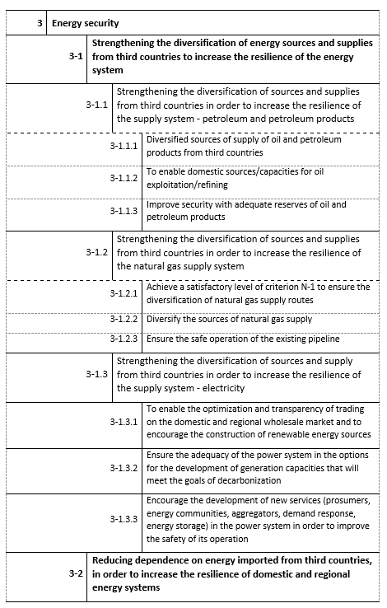
Energy Security
Objective:
Ensure stable, diversified, and reliable energy supply in Bosnia and Herzegovina by reducing import dependency, strengthening domestic capacities, and enhancing the resilience of the energy system.
Policies and Measures:
Strengthening diversification of energy sources and supply, including the development of domestic capacities and cross-border interconnections (electricity, gas, renewables).
Reducing dependence on energy imports from third countries through increased domestic production, rationalization of consumption, and strengthening of regional system resilience.
Enhancing the flexibility of the energy system, particularly through the use of domestic resources, demand management, and the development of energy storage capacities.
Enabling the application of new technologies and management tools for rapid response to supply disruptions and system balancing.
Protection against cyberattacks through the development of institutional and technical measures to ensure the security of critical energy infrastructure.
Development and modernization of the electricity distribution network to increase reliability, resilience, and integration of renewable energy sources.
Strengthening mechanisms for crisis planning and emergency response, including fuel reserves, contingency plans, and security protocols.

Slide 11
Energy Security
Reporting:
Energy Security Report: report on the security of supply, capacities, and resilience in accordance with Article 14 of Directive (EU) 2019/944.
PaMs Report: description of measures contributing to supply security, storage, and system flexibility; report on the status and development of electricity and gas infrastructure, including interconnections and energy storage.
Progress Report: analysis of the impact of energy security measures on system stability and sustainability.
Regional Cooperation Report: report on cross-border cooperation and joint security mechanisms.

Slide 12
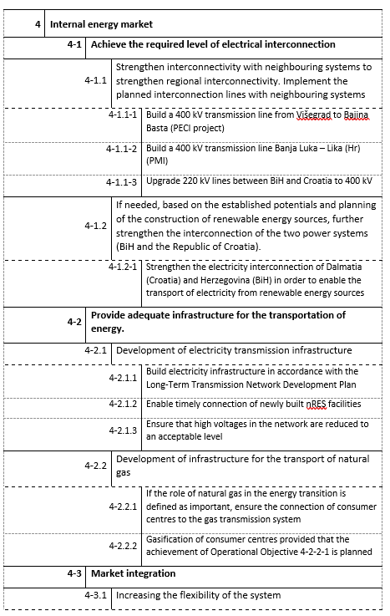
Internal Energy Market
Objective:
Ensure the establishment of a functional, competitive, and integrated internal energy market that enables effective decarbonization and energy transition.
Policies and Measures:
Achieve the required level of electricity interconnection – enhance the interconnections of power systems with neighboring countries to increase stability and regional integration.
Ensure adequate energy transport infrastructure – modernize and expand transmission and distribution networks to support market development and integration of renewable energy sources.
Market integration – align legislation and market rules with EU Directive (EU) 2019/944 on common rules for the internal electricity market and Regulation (EU) 2019/943 on the functioning of the internal electricity market.
Ensure adequate treatment of energy poverty (protection of vulnerable consumers) – establish social protection mechanisms and subsidy programs within market reforms, in line with Directive (EU) 2023/1791 on energy efficiency.

Slide 13
Internal Energy Market
Reporting:
Report on the Internal Energy Market – progress in market liberalization, regulatory alignment, and strengthening of competition.
Energy Security Report – status of interconnections, investments, and supply security.
Report on Energy Poverty and Just Transition – identification of vulnerable consumers and protection measures in the context of market changes.

Slide 14
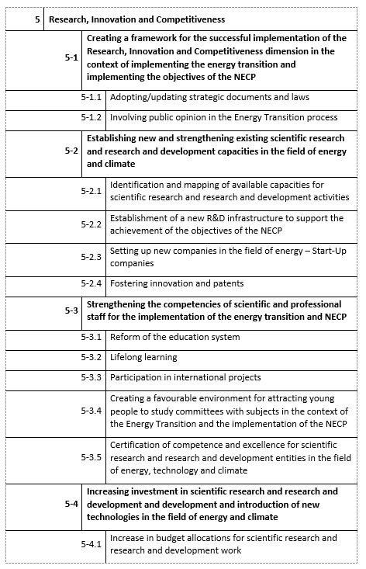
Research, Innovation, and Competitiveness
Objective:
Increase investment in research and development, strengthen innovation capacities and competitiveness of the energy sector through modernization, digitalization, and the development of new technologies for decarbonization.
Policies and Measures:
Establishing a framework for effective implementation of research, innovation, and competitiveness in the context of the energy transition and NECP goals — development of national policies and strategies for innovation aligned with the EU Strategic Energy Technology Plan (SET-Plan).
Establishing new and strengthening existing scientific and R&D capacities in the field of energy and climate — creation of centers of excellence, laboratories, and partnerships between academia and industry.
Enhancing competencies of scientific and professional staff for implementing the energy transition and NECP — training programs, knowledge exchange, and international cooperation (Horizon Europe, LIFE Program).
Increasing investment in research, development, and deployment of new technologies in energy and climate — introduction of financial instruments supporting innovative projects, pilot facilities, and start-ups.
Improving mechanisms for encouraging innovation and patents in the energy and climate sectors — development of intellectual property systems and fiscal incentives for innovations with green effects.

Slide 15
Research, Innovation, and Competitiveness
Reporting:
Report on Research, Innovation, and Competitiveness
Monitoring investments in research, innovation, and competitiveness in accordance with Article 17 of Regulation (EU) 2018/1999 on the Governance of the Energy Union,
Overview of the implementation of research projects and their contribution to decarbonization goals,
Analysis of capacities, investments, and technology transfer in the energy sector.

Slide 16
Horizontal Policies and MRV System
Objective:
Establish a functional, transparent, and interoperable system for monitoring, reporting, and verification (MRV) of energy and climate policies in Bosnia and Herzegovina, in accordance with EU regulations and EEA requirements.
Policies and Measures:
Establishment of an integrated MRV system for energy and climate (NECP MRV) – consolidation of data on GHG emissions, energy, efficiency, RES, market, and security into a unified database with regular reporting.
Strengthening the institutional and coordination framework – defining the roles of state, entity, and local institutions in data collection, verification, and processing (in accordance with Chapter 5 of the NECP).
Establishment of a legal and regulatory framework for data management – alignment with EU Regulation (EU) 2018/1999 on the Governance of the Energy Union and INSPIRE standards for environmental data interoperability.
Standardization of reporting formats and digitalization of processes – implementation of INSPIRE and ISO standards, development of a digital platform for reporting to the EEA and the European Commission.
Strengthening institutional capacities and staff training – continuous capacity building for the application of methodologies (GHG inventory, PaMs, Projections, Energy Efficiency Indicators).
Ensuring transparency and data accessibility – public access to key indicators and integration with European information systems (EIONET, EEA portal).

